Slide 1

CSA0211-C PROGRAMMING
BUS TRANSPORT SCHEDULING AND PASSENGER MANAGEMENT SYSTEM WITH ROUTE ALLOCATION,SEAT BOOKING,AND FARE PROSESSING USING STRUCTURES AND FILES
PRESENTED BY
M. NISHANTH (192511154)
J. JAYAKUMAR(192511159)
K.RAMANA(192521270)
UNDER THE GUIDANCE OF
Dr. S. K. SARAVANAN

Slide 2


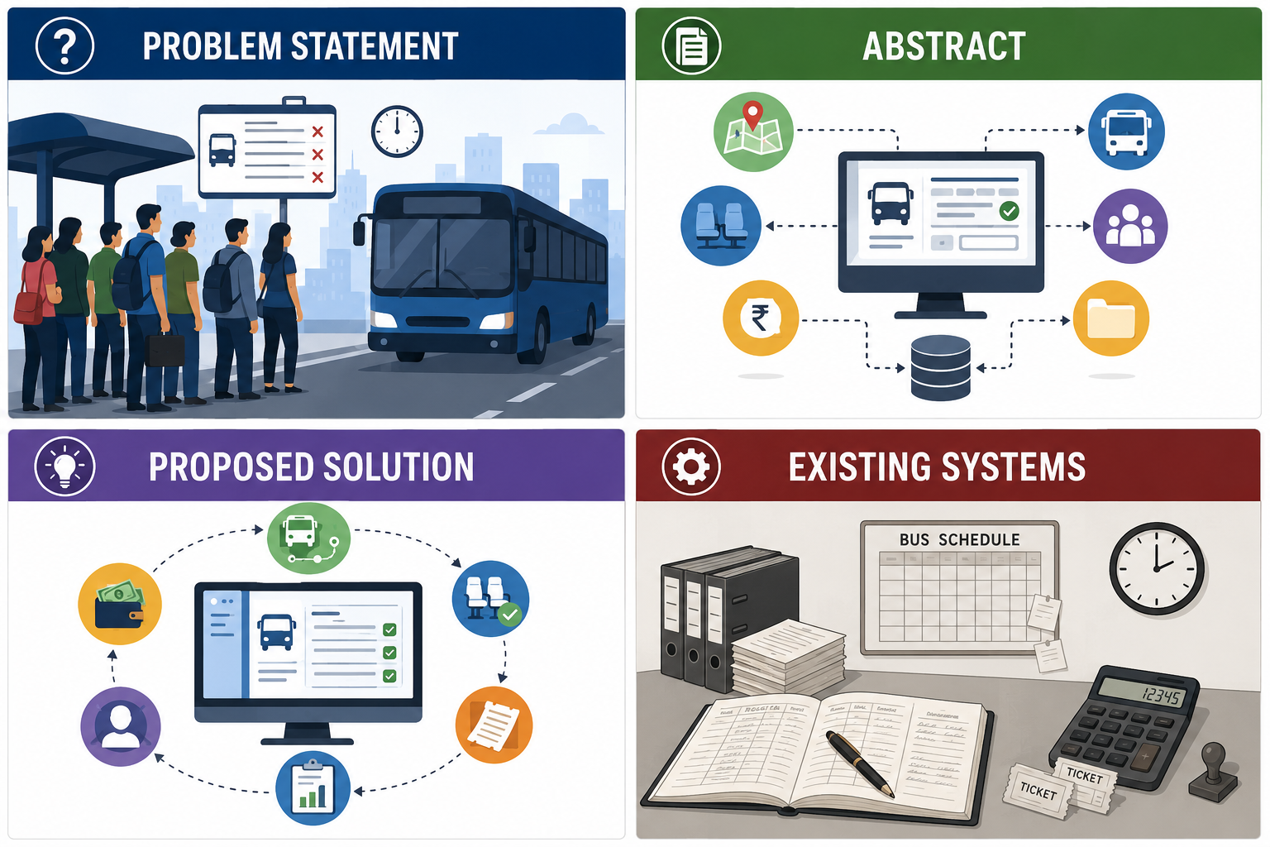
PROBLEM STATEMENT
Manual management of bus routes, schedules, and passenger records is time-consuming.
Seat booking and fare calculation are prone to human errors.
Maintaining paper-based booking records makes data retrieval difficult.
Duplicate seat allocation and inaccurate passenger information may occur.
There is a need for an automated system to efficiently manage bus scheduling, passenger booking, fare processing, and record storage.
Objective :
To develop a Bus Transport Scheduling and Passenger Management System using Structures and File Handling in C that automates route allocation, seat booking, fare calculation, and booking record management.

Slide 3
ABSTRACT
The Bus Transport Scheduling and Passenger Management System is designed to automate bus scheduling and passenger booking operations.
The system manages route allocation, bus schedules, and passenger registration efficiently.
It provides seat booking by checking seat availability and preventing duplicate bookings.
The system performs automatic fare calculation based on the selected route.
Booking details are securely stored and managed using file handling for easy retrieval and updates.
The project is developed using C programming, implementing structures, functions, and file handling concepts.
The proposed system reduces manual effort, improves accuracy, and ensures efficient management of transport operations.

Slide 4
EXISTING SYSTEMS & LIMITATIONS
Existing System
Bus schedules and route details are maintained manually.
Passenger registration and seat booking are performed using paper records or basic spreadsheets.
Fare calculation is done manually, increasing the possibility of errors.
Booking records are difficult to update, search, and maintain.
There is no centralized system for managing transport operations.
Limitations
Time-consuming process
Prone to human errors
Duplicate seat bookings may occur
Difficult to retrieve passenger and booking records
Increased paperwork and data redundancy

Slide 5
PROPOSED SYSTEM
Features
Automates route allocation and bus schedule management.
Registers passenger details efficiently.
Checks seat availability before booking.
Performs automatic fare calculation based on the selected route.
Stores and manages booking records using file handling.
Allows easy searching, updating, and viewing of booking information.
Reduces manual work and improves data accuracy.

Slide 6
LITERATURE SURVEY
Paper Title | Key Findings | Limitation
Bus Reservation System | Provides online bus booking and passenger reservation. | Does not effectively manage bus schedules and route allocation.
Transport Management System | Manages bus routes and schedules efficiently. | Limited support for passenger booking and fare processing.
Passenger Reservation Management System | Automates passenger registration and seat booking. | Does not provide complete booking record management using file handling.
Research Gap
Existing systems focus on individual transport management functions.
Limited integration of route allocation, seat booking, fare calculation, and booking record management.
Our project combines all these functionalities into a single application using C Programming, Structures, and File Handling.

Slide 7
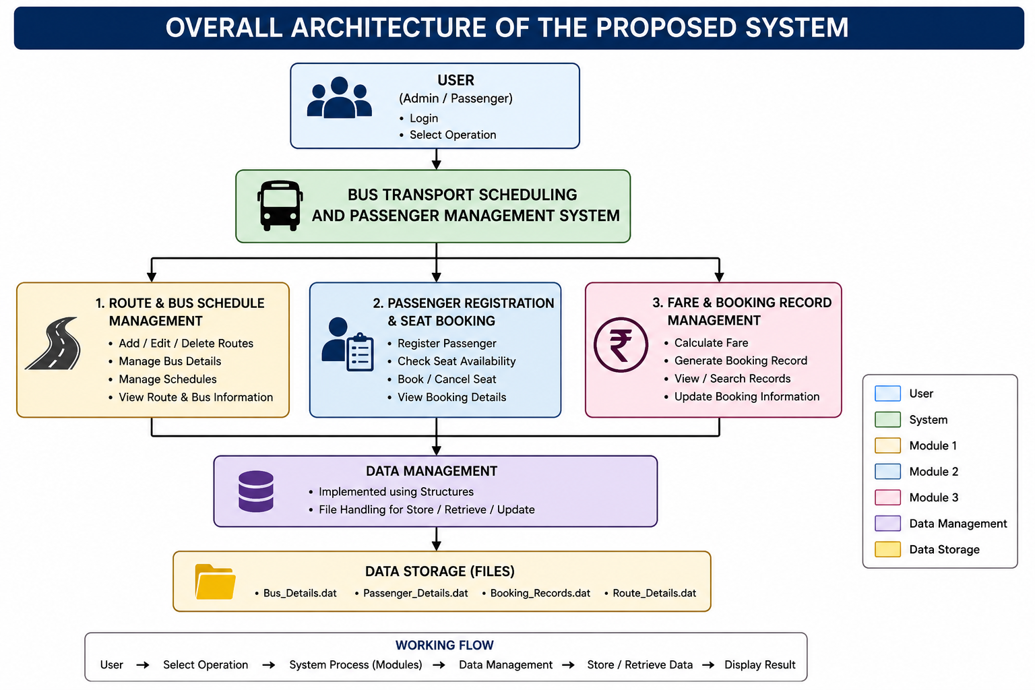
ARCHITECTURE DIAGRAM

Slide 8
ALGORITHM IDENTIFIED
Algorithm / Technique | Purpose & Operations
Searching Algorithm | Linear Search – Searches passenger details, bus details, and booking records.
Sorting Algorithm | Bubble Sort – Organizes bus schedules, routes, and booking records.
Seat Allocation Algorithm | Checks seat availability → Assigns seat number → Updates booking status.
Fare Calculation Algorithm | Takes source & destination → Calculates distance → Generates ticket fare.
File Handling Algorithm | Stores and manages records using Create, Read, Write, and Update operations.

Slide 9


